Slide 1
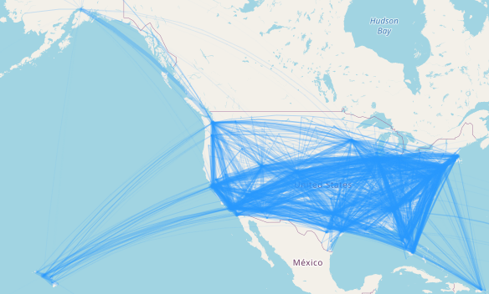
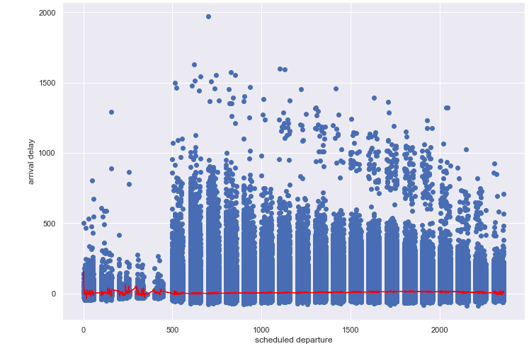
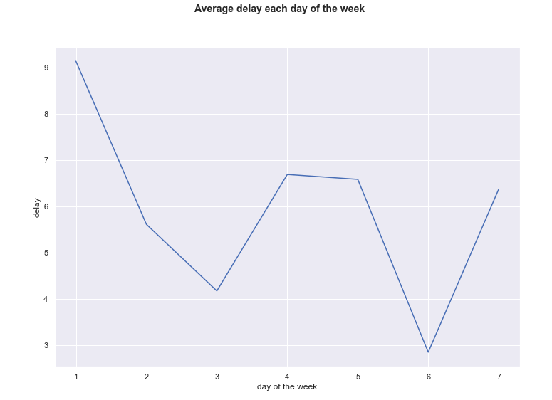
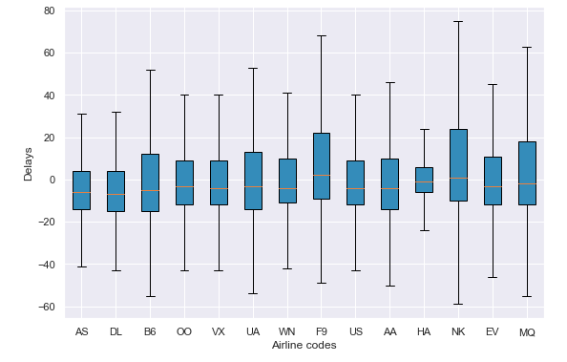
Building a Prediction Model for Flight Delays
Using Machine Learning
Introduction
Building the Prediction Model
In the current landscape, flight delays are a common issue that poses problems for both passengers and airlines: for a passenger they can attract travel difficulties, while for the airlines flight delays can result in huge financial losses.
The aim of this project is to create a prediction model that can provide accurate forecasts on how much delay a flight will have before take off,
This task is treated as a regression problem and will make use of a dataset containing. Information on flights recorded in 2015 to learn how to predict similar delays as accurately as possible.
The train test was split, with the purpose of performing cross correlation for hyperparameters tunning.
In the model, the Arrival hour, Origin airport, destination airport and airline were used as categorical variables.
The first model that was implemented was a simple linear regression model – this has shown very poor results,, thus it was necessary to find a model that can capture non-linear relationships between input features and the output variable.
Because of the large size of the dataset and how structured it is,, a Random Forest Regressor was used to predict the relationship between the arrival delay and the put features..
These model has resulted in highly accurate results on the input variables resulted from the in terms of the mean absolute error and root mean squared error. Future improvements to the model were attempted, but non has generated a higher accuracy.
.
Methodology
Data cleaning
Improvements and future work
In the initial data cleaning, we dropped the NA values from the train set. We group the 3 columns representing the date - day, month, year- in one datetime column, representing a DAY-MONTH field of a flight. The year was dropped as it was redundant ( always 2015). Two other columns were dropped after experiments as they were not bringing any improvement to the model: the flight number, tail number, distance, departure time and the time elapsed from departure to wheels off.
The delays in the initial dataset had also negative values, representing arrivals that were before the scheduled time. These are not within the scope of the analysis and for the model to not treat them as delays, for every negative delay , the delay becomes 0.
Because we were not able to improve the accuracy of the model further, an improvement we searched was to look at how external factors influence the arrival delays of flights. Even if beyond the scope of the competition, we looked further into how we can improve result and offer a more realistic model.
Because weather data was deemed a good indicator of possible delays,, we used an airport weather observations archive from ISU to enrich the dataset, A Python scraper was used to extract historical METAR data from airports around the world and this was merged with the initial dataset on datetime objects. After data cleaning was performed, there were several airports that had no METAR information available
Results
Scatterplot of delays
Exploratory Data Analysis
Conclusion
The information in the dataset was used to find dependencies and correlations between variables, as shown in Figure 1:
The boxplot shows how the airline impacts the departure delay - there doesn’t seem to be a big difference between the airlines.
We plotted the routes of flights and color coded them based on the delay - green are mild delays, yellow are medium, while red and black represent critical delays. We can see most flights have mild delays, but there are certain routes where the chances of high delays are empirically higher.
Next, we plot the temporal variability of the delay based on two fields: month, day, and the two combined. Out of the 3, the day of the week showed the highest correlation.
Based on the correlation heatmap analysis, the most highly correlated variables to the arrival delay were
Delay per Airline
Add your information, graphs and images to this section.
MAE | 4.325
Random MAE | 22.350
MSE | 68
MSE on train set | 1.774
MAE on train set | 22.350
MSE train | 14
References
Hyperparameters Tunning
https://mesonet.agron.iastate.edu/request/download.phtml?network=CO_ASOS
For hyper-parameters tunning, a random search of parameters using 3-fold cross-validation was used across 100 different combinations. The training set was split into 0.05 fraction samples with a high random state generator,. The hyperparameters that were to be estimated were the number of trees in the random forest, the number of features to consider at every split, the max depth of the tree, the minimum samples required to split a node and at each node

